Slide 1
Extending your Datacenter with Azure
Vandy Rodrigues
Cloud Solution Architect

Slide 2
Why Extend your Datacenter with Azure today?
Connectivity
Identity
Management
DevOps

Slide 3
Extending your Datacenter with Azure - delivers consistent management anywhere, anytime
DevOps
OMS
Azure & AWS
Windows & Linux
Web Apps
Backup
Archiving
DR Site
Azure Active Directory
Domain Controllers
Multi-Factor Authentication
LDAP & SAML
Azure VPN Gateway
NVA Appliance
ExpressRoute
Azure VNET

Slide 4

Connecting your Datacenter to Azure
Driving consistency

Slide 5



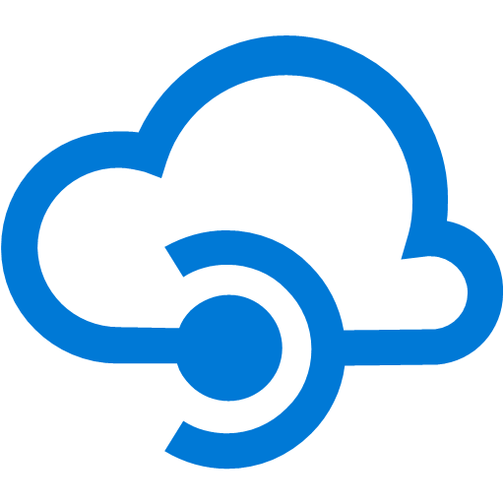
















































Platform Services
Security and Management
Compute
Web and mobile
Developer services
Hybrid
Operations
Cloud services
Service fabric
Web Apps
API Apps
API Management
Visual Studio
Azure SDK
Portal
Azure AD Connect Health
Active Directory
Batch
Remote app
Mobile Apps
Logic Apps
Notification Hubs
Team Project
Application Insights
AD Privileged Identity Management
Multi-factor Authentication
Integration
Analytics and IoT
Data
Backup
Automation
Storage queues
Biztalk Services
HDInsight
Machine Learning
SQL Database
SQL Data Warehouse
Operational Insights
Key vault
Hybrid Connections
Service Bus
Data Factory
Event Hubs
Redis Cache
Search
Import/Export
Store/ Marketplace
Media and CDN
Site Recovery
Stream Analytics
Mobile Engagement
DocumentDB
Tables
VM Image Gallery and VM Depot
Media Services
Content Delivery Network (CDN)
StorSimple
Infrastructure Services
Compute
Storage
Networking
Virtual Machine
Containers
BLOB Storage
Azure Files
Premium Storage
Virtual Network
Load Balancer
DNS
Express
Route
Traffic Manager
VPN Gateway
Application Gateway
Datacenter Infrastructure (24 regions, 19 online)

Slide 6
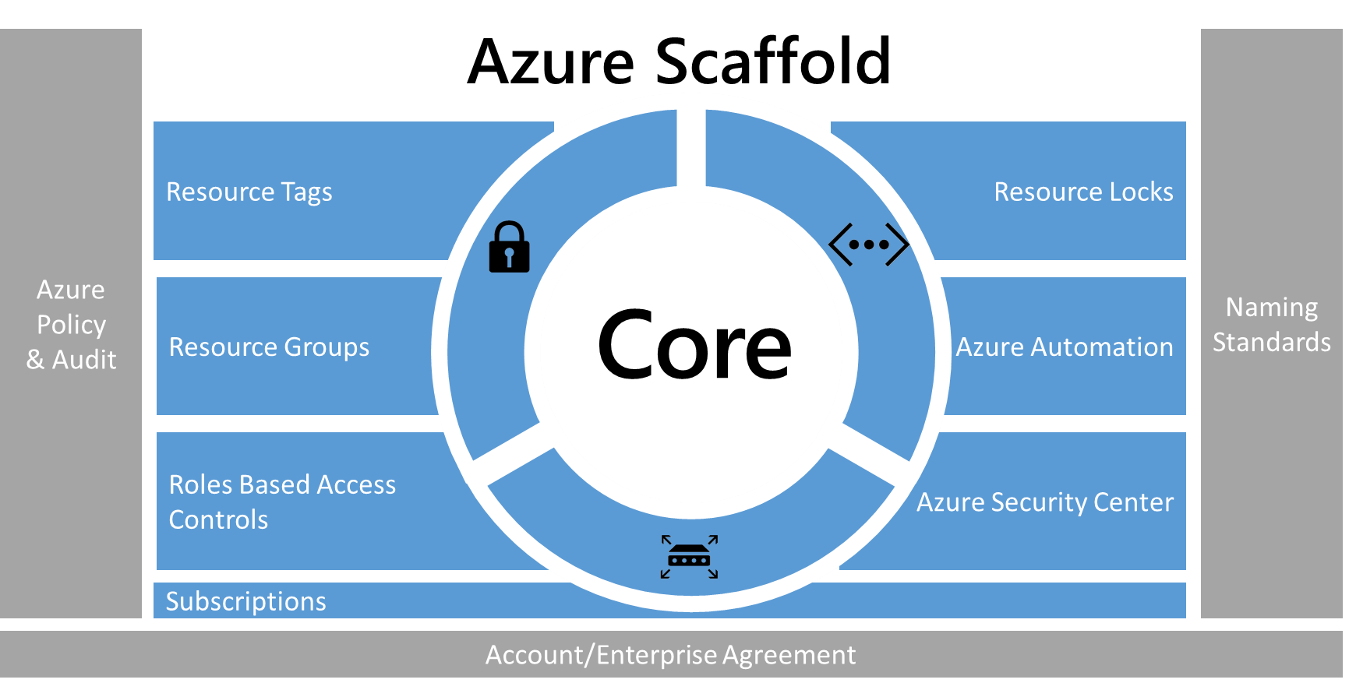

Prescriptive Subscription Governance
1
2
3
Notes:
Azure enterprise scaffold - prescriptive subscription governance
https://docs.microsoft.com/en-us/azure/azure-resource-manager/resource-manager-subscription-governance
Get yourself familiar with Azure Templates and Automation deployment
Understand the structure and syntax of Azure Resource Manager templates
https://docs.microsoft.com/en-us/azure/azure-resource-manager/resource-group-authoring-templates
Terraform
https://docs.microsoft.com/en-us/azure/virtual-machines/linux/terraform-install-configure
Ansible
https://docs.microsoft.com/en-us/azure/virtual-machines/linux/ansible-install-configure
Jenkins
https://docs.microsoft.com/en-us/azure/jenkins/overview

Slide 7
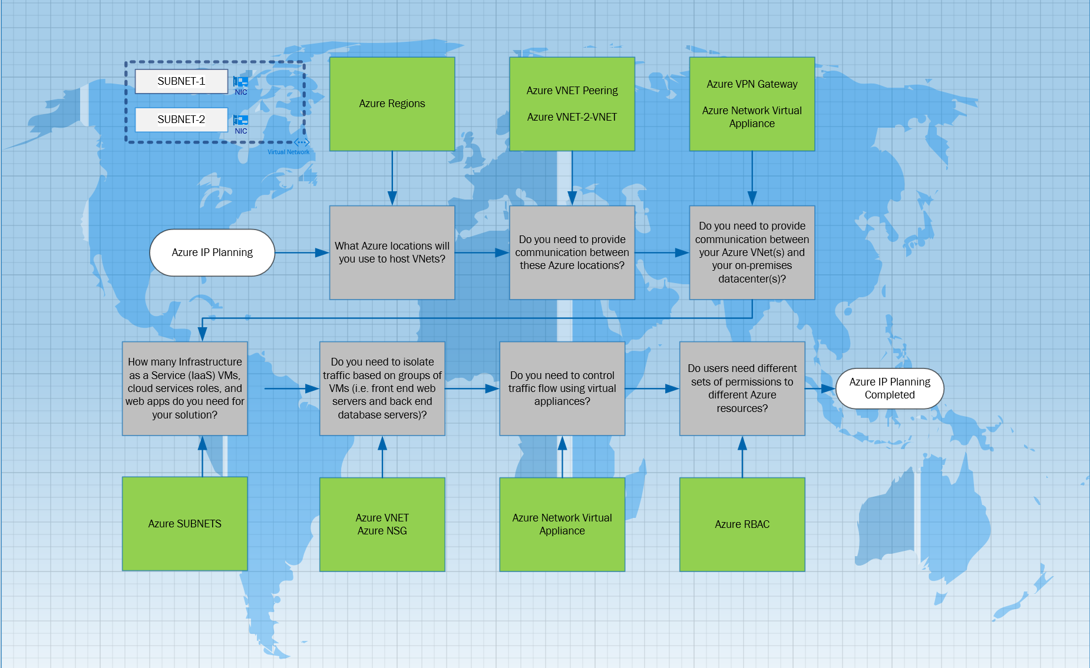
Plan and design Azure Virtual Networks
https://azure.microsoft.com/en-us/documentation/articles/virtual-network-vnet-plan-design-arm/
Notes:
You can build the entire Azure Network Infrastructure in a few minutes with Azure CLI and JSON templates.
Highlight the importance to chose a Networking IP schema for Azure VNETs that are scalable and will be let you connecting to other Azure region with VNET peering, S2S, VNET-2-VNET as well as VPN connection to AWS or Google.
Example: Azure IP Schema VNET 10.0.0.0/20
This networking schema will allow you to have 4096 subnets and 4096 hosts per subnet.
Region – US South Central VNET 10.0.0.0/20
Subnet schema will allow to have 510 hosts per VNET allowing the scalability
Subnet 1 : 10.0.0.0/23
Subnet 2 : 10.0.2.0/23
Subnet 3 : 10.0.4.0/23
Region – US West VNET 10.1.0.0/20
Subnet 1 : 10.1.0.0/23
Subnet 2 : 10.1.2.0/23
Subnet 3 : 10.1.4.0/23
Create a virtual network using the Azure CLI
https://docs.microsoft.com/en-us/azure/virtual-network/virtual-networks-create-vnet-arm-cli
Create network security groups using the Azure CLI
https://docs.microsoft.com/en-us/azure/virtual-network/virtual-networks-create-nsg-arm-cli

Slide 8
Connecting your Datacenter to Azure
Azure Enterprise Scaffold
Design Azure VNET
Security Best Practices
1
2
3
Azure Enterprise Scaffold
Azure Resource Groups Guidelines
Azure Storage Group Guidelines
Manage Resources and Control Access
Design Azure VNET
Azure Site-2-Site VPN
Azure VNET Peering
Network security groups
Security Best Practices
Network Security
Notes:
Additional Topics:
ExpressRoute technical overview
https://docs.microsoft.com/en-us/azure/expressroute/expressroute-introduction
Azure ARM Template
https://azure.microsoft.com/en-us/resources/templates/
Azure Marketplace
https://azuremarketplace.microsoft.com/en-us/marketplace/apps?page=1
Resource policy overview
https://docs.microsoft.com/en-us/azure/azure-resource-manager/resource-manager-policy
Azure enterprise scaffold - prescriptive subscription governance
https://docs.microsoft.com/en-us/azure/azure-resource-manager/resource-manager-subscription-governance

Slide 9



Extending Identity to Azure
Driving consistency

Slide 10



Hybrid Cloud Scenarios
Enterprise Mobility Suite
Hybrid Identity Management
Mobile Device Security& Management
Mobile Application Management
Strong Authentication & Access based Information Protection
Microsoft Azure Active Directory
Encrypted Synchronization
Microsoft apps
Microsoft Azure AD
Consumer identity providers
Custom LOB apps
ISV/CSV apps
Active Directory
PCs and devices
3rd party clouds/hosting
Microsoft Azure Multi-Factor Authentication
Built-in
SDK for integration
Strong multi Factor Authentication
Real Time Fraud Alert
Reporting, Logging & Auditing
Enables compliance with NIST 800-63 Level 3, HIPAA, PCI DSS, and other regulatory requirements
.NET, Java, PHP, …
Multi-Factor
Authentication Server
ADFS / SAML
Microsoft Azure AD
Cloud Apps
Multi-Factor
Authentication Server
On Premises
Applications
BYOD / Personal devices
Active Directory
Corporate devices
Notes:
Microsoft Azure Active Directory is a comprehensive identity and access management cloud solution. It combines core directory services, advanced identity governance, security and application access management. Microsoft Azure Active Directory also offers to developers an identity management platform to deliver access control to their applications, based on centralized policy and rules. For enterprises with more demanding needs an advanced offering, Microsoft Azure Active Directory Premium, currently in preview, helps complete the set of capabilities that this identity and access management solution delivers.

Slide 11

Extending your Identity to Azure
Azure AD Connect
Deploy DCs on Azure
Azure AD
1
2
3
Connect AD with AD Connect
Azure AD Connect and Federation
Deploy Windows AD on Azure VMs
Deploy ADFS on Azure VMs
Azure AD Identity Protection
Hybrid Identity Lifecycle

Slide 12

Protecting your Datacenter with Azure
Driving consistency

Slide 13
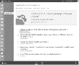

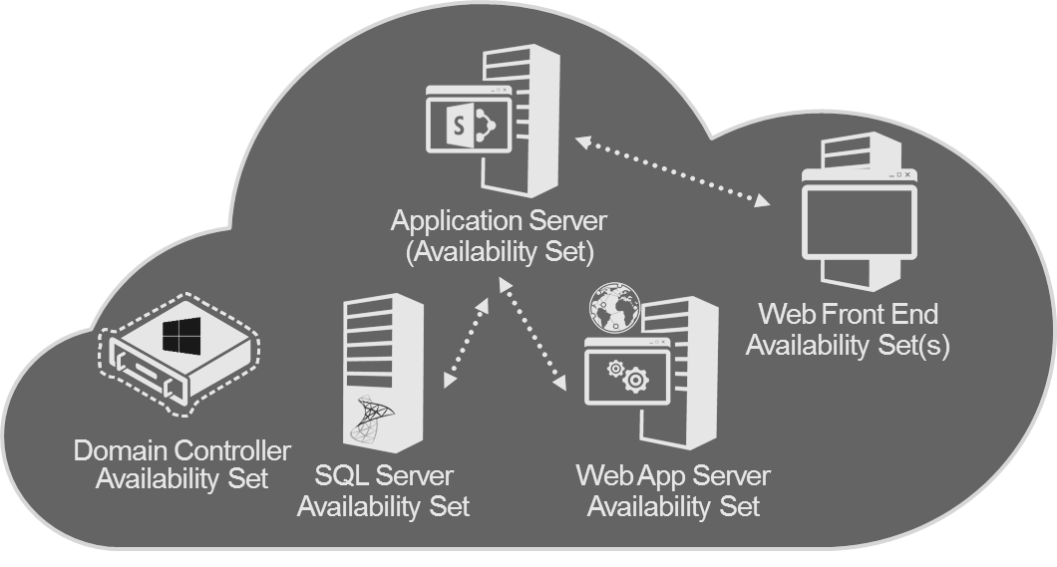
Hybrid Cloud Scenarios
Azure Backup
SQL
Encrypted Backup
VPN
File Server
Recovery
Exchange
Windows Backup
SC Data Protection Manager
Microsoft Azure
Azure Site Recovery
Replication
Site B
Site A
Recovery
System Center
Virtual Machine
Manager
Microsoft Azure
Health Monitor
Hyper-V
Replica
Manage
Microsoft Azure
Site A
Site B
Recovery
plan
System Center
Virtual Machine
Manager
System Center
Virtual Machine
Manager
Orchestrated Recovery in case of outage
Development / Test (SharePoint)
VPN
Active Directory
Admin
Remote Users
Notes:
Windows Azure Active Directory is a comprehensive identity and access management cloud solution. It combines core directory services, advanced identity governance, security and application access management. Windows Azure Active Directory also offers to developers an identity management platform to deliver access control to their applications, based on centralized policy and rules. For enterprises with more demanding needs an advanced offering, Windows Azure Active Directory Premium, currently in preview, helps complete the set of capabilities that this identity and access management solution delivers.

Slide 14
Protecting your Datacenter with Azure
Backup
Business Continuity & Disaster Recovery
High Availability
1
2
3
Azure Backup
Azure Marketplace
ASR Deployment Scenarios
ASR Capacity Planner
DR and HA for applications built on Azure
Azure Traffic Manager

Slide 15
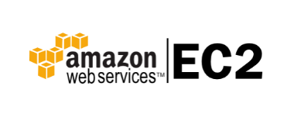

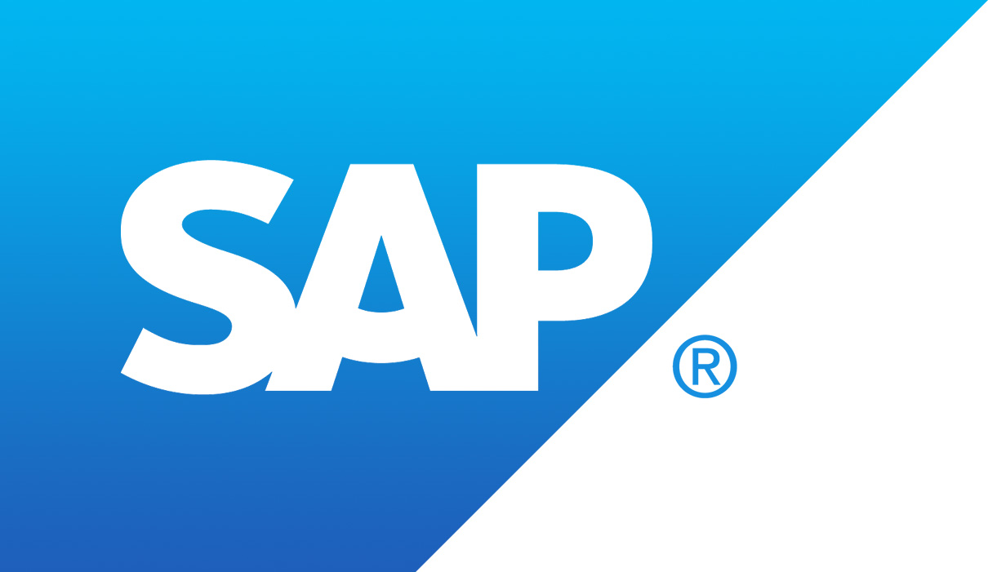
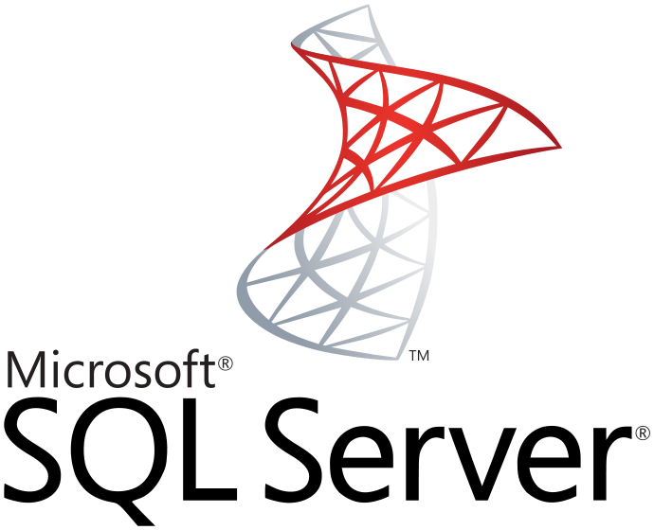



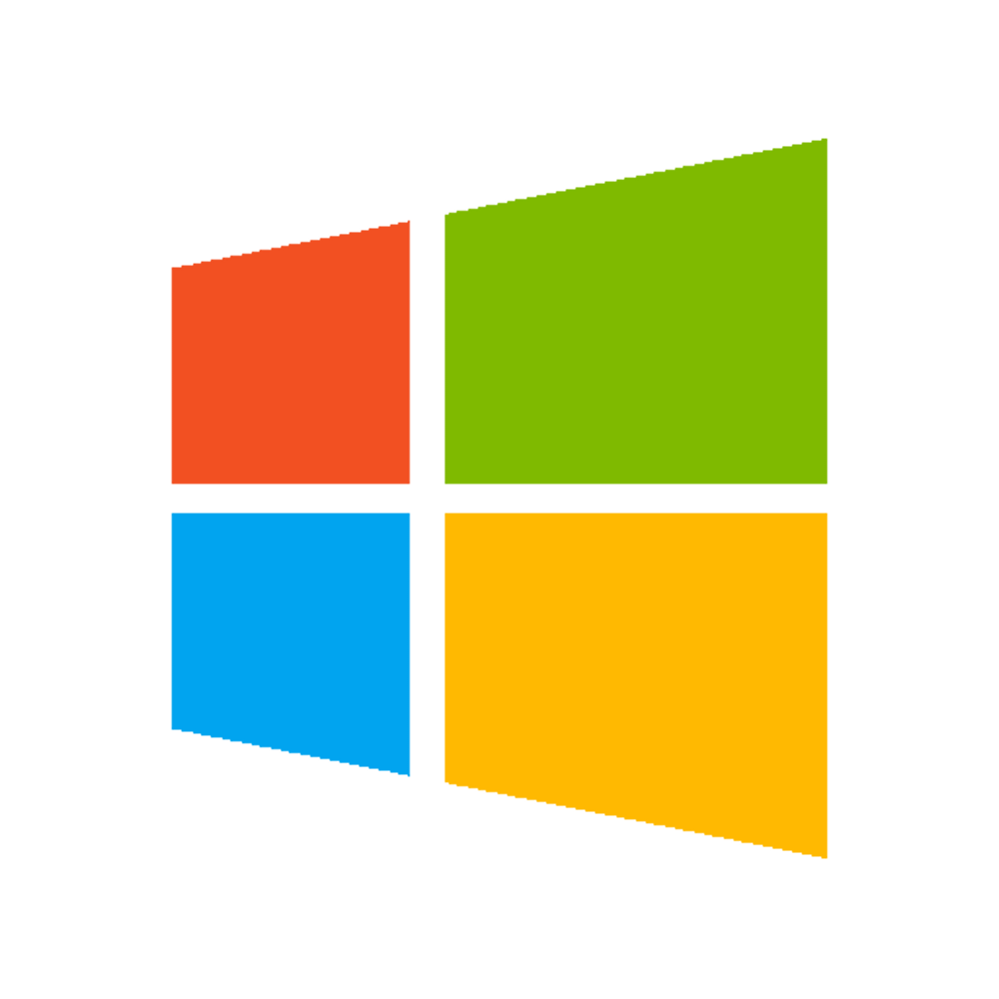

Replication & Migration of workloads
Heterogeneous Platform Support
Cloud 1st Service
Datacenter Extension
A true Public Cloud DR Service is on-demand, heterogeneous, and automated.
Data Replication forms a constant connection to the Public Cloud. Your data can become usable on demand for Recovery, Testing, or Migration.
SQL Replication requirement list here
Hyper-V requirement list here
VMware/Physical requirements here
Migration
DR Service
Replication
Cloud Storage
Physical Servers
Virtual Machines
On Demand Infrastructure for a variety of uses

Slide 16
Managing your Datacenter with OMS
Driving consistency

Slide 17
Managing your Datacenter with OMS
OMS Demo Enviroment
Log Analytics
Security & Compliance
1
2
3
OMS Experience demo
Get started with Log Analytics
Connect computer to Log Analytics
Add OMS Solutions
OMS and Audit Solution
Update and Management Solution
Investigating Suspicious Activity

Slide 18

IT solutions are not silos—your business continuity solutions shouldn’t be
Physical
Virtual
Hybrid Cloud
Cloud
On-premises—built and managed infrastructure
Cloud—flexible, remote infrastructure
Microsoft Azure provides solutions and drives consistency across all four scenarios

Slide 19
DevOps Continuous Deployment
Driving consistency
Notes:
Tutorial: DevOps with the Azure Portal
https://docs.microsoft.com/en-us/azure/azure-portal/tutorial-azureportal-devops

Slide 20
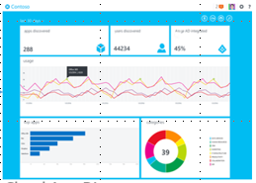
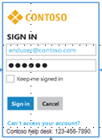
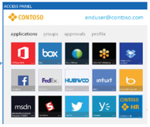
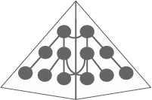

Web Apps
Developer
Develop secure cloud apps
Using ADAL and Graph API
Cloud App Discovery
Azure Right Management Service
Azure AD Premium
Custom sing-on
experience
Users see and launch cloud apps
Azure AD Application
Proxy Connectors
HTTP LOB App
On Premise User
Remote User
Active Directory
Windows Server AD/ADFS
Multiforest
DirSync/AADSync/password writeback
Notes:
https://docs.microsoft.com/en-us/azure/azure-portal/tutorial-azureportal-devops

Slide 21
Azure is my next Datacenter
2
3
1st week
2nd week
3rd week
4th week
1
DevOps
OMS
Azure & AWS
Windows & Linux
Azure Active Directory
Domain Controllers
Multi-Factor Authentication
LDAP & SAML
Backup
Archiving
DR Site
Web Apps

Slide 22

© 2014 Microsoft Corporation. All rights reserved. Microsoft, Windows, and other product names are or may be registered trademarks and/or trademarks in the U.S. and/or other countries.
The information herein is for informational purposes only and represents the current view of Microsoft Corporation as of the date of this presentation. Because Microsoft must respond to changing market conditions, it should not be interpreted to be a commitment on the part of Microsoft, and Microsoft cannot guarantee the accuracy of any information provided after the date of this presentation. MICROSOFT MAKES NO WARRANTIES, EXPRESS, IMPLIED OR STATUTORY, AS TO THE INFORMATION IN THIS PRESENTATION.

